Slide 1
Understanding Health and Wellness through Microbiome research
30th July – 1st August 2025
Dr. Tarini Shankar Ghosh
Microbiome Informatics
IIIT-Delhi
Day 3
Lecture 1

Slide 2
What we are going to cover today..

Slide 3
Databases
Reference Databases
16S and other amplicon data
Whole Genome Sequences
Functional Databases
Microbiome Databases
Microbiome Study Databases
Metagenome-Assembled Genome Databases

Slide 4
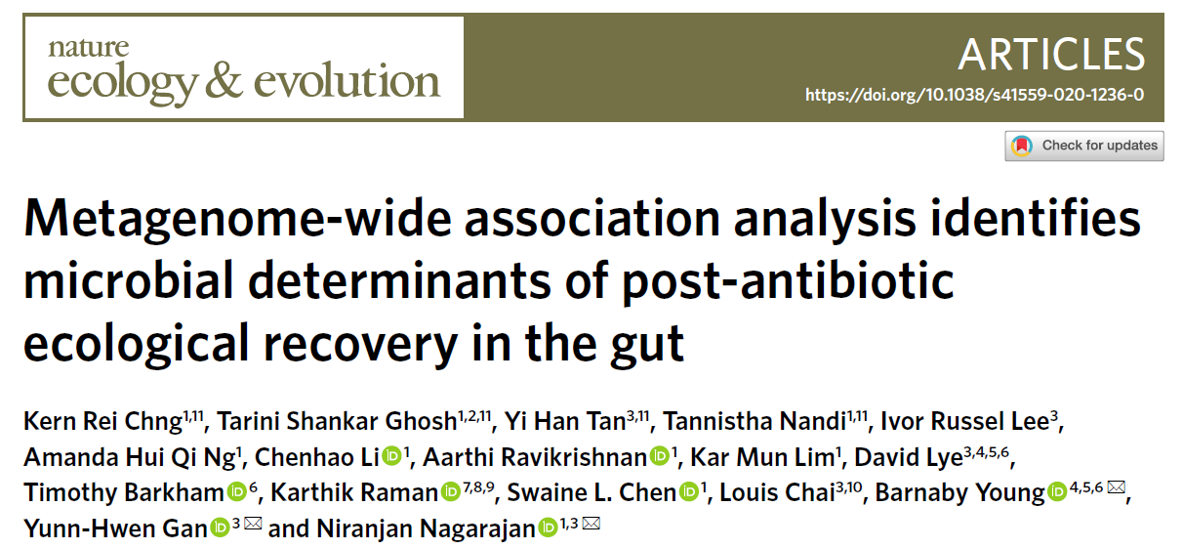
Case Studies: Obtaining insights using publicly available data
Data-driven identification of bacteria associated with recovery post-antibiotic treatment

Slide 5
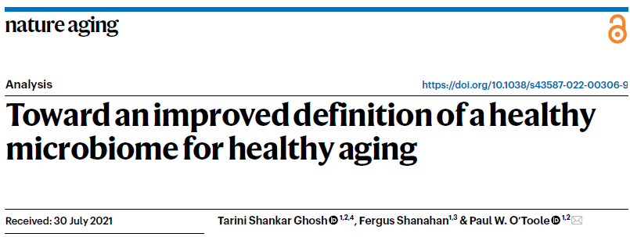
Case Studies: Obtaining insights using publicly available data
Alterations of the gut microbiome with aging and unhealthy aging

Slide 6
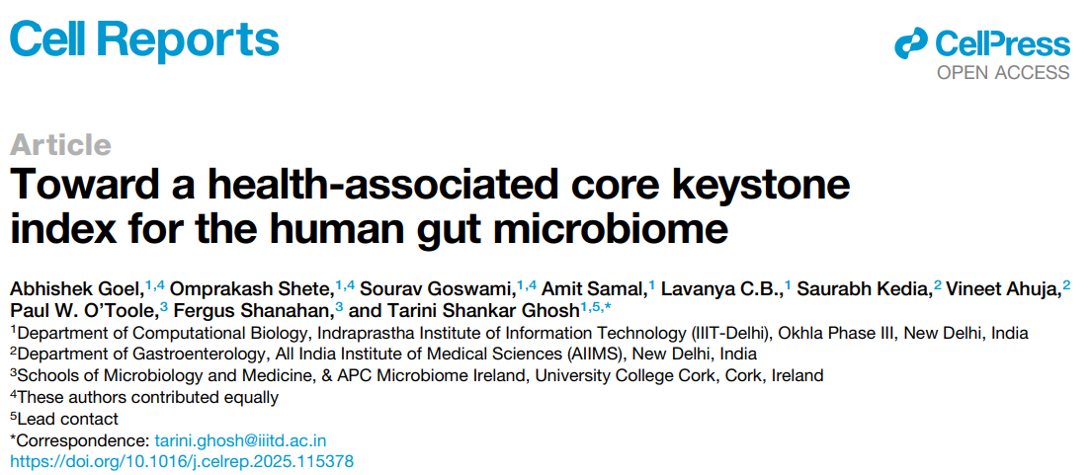
Case Studies: Obtaining insights using publicly available data
Global Ranking of 201 gut microbes using large microbiome data collection

Slide 7
Lastly
Video links
To upload your original samples to ENA
Links to understand the sample collection

Slide 8
Reference Databases

Slide 9
What are reference databases?
What are reference databases?
Reference Databases contain sequences of genes, genomes, proteins from organisms that have been previously studied.
Whose genomes, genes and proteins have been sequenced and deposited in these databases
They basically contain information from all ‘known’ realms of life.
These help us to annotate, classify data from newly explored environments
And build census of different microbes and functions in microbiomes

Slide 10
There are various reference databases for different kinds of data

Slide 11
16S and other amplicon data
Ribosomal Database Projects (RDP)
http://rdp.cme.msu.edu/
Greengenes Database
https://greengenes.secondgenome.com/
SILVA Database
https://www.arb-silva.de/
UNITE Database
https://unite.ut.ee/#main

Slide 12
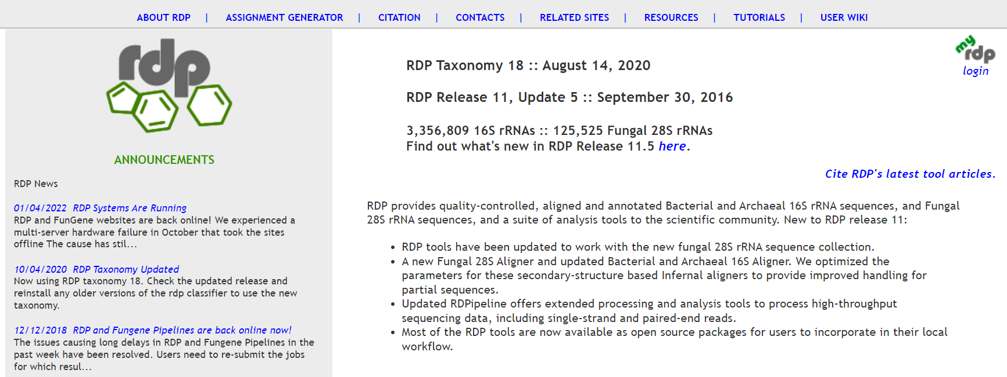
Ribosomal Database Projects (RDP)
Ribosomal Database Projects (RDP)
Weblink: http://rdp.cme.msu.edu/
16S analysis workflow: http://rdp.cme.msu.edu/tutorials/workflows/16S_supervised_flow.html

Slide 13
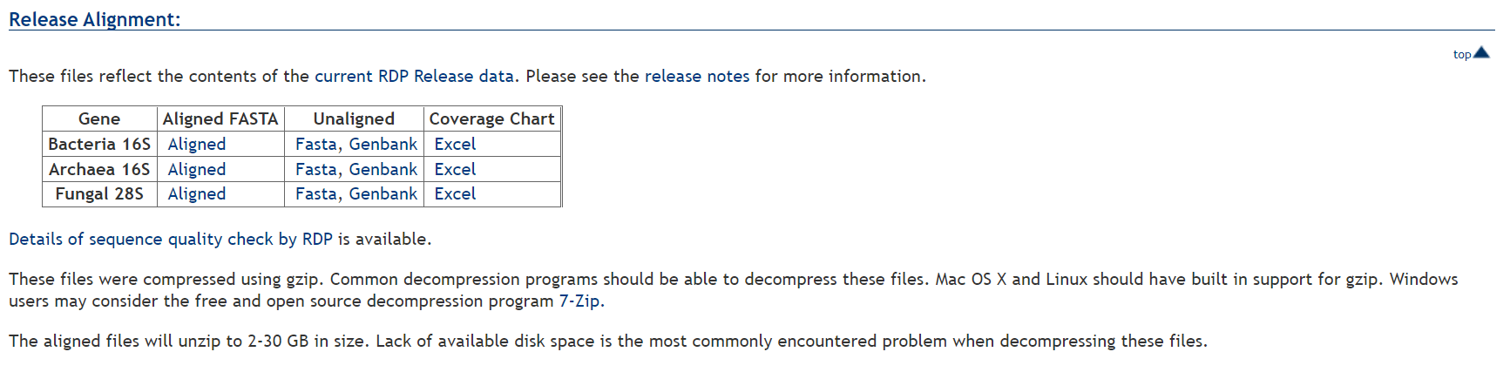
Ribosomal Database Projects (RDP)
RDP Download Link: http://rdp.cme.msu.edu/misc/resources.jsp
Aligned: Multiple Sequence Alignment format
Fasta: General Fasta Format
Genbank: Another sequence format
Excel: Tabular

Slide 14
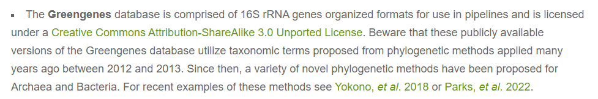
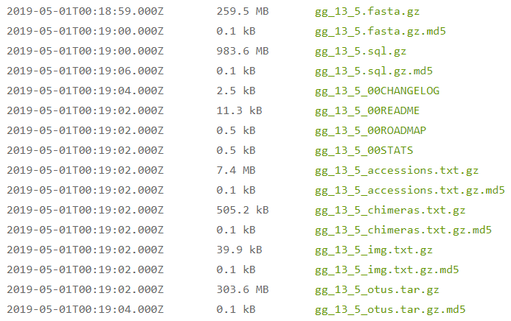
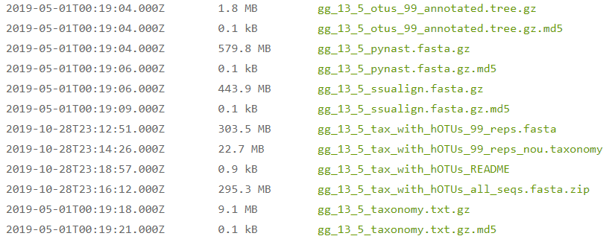
Greengenes Database
Greengenes Database
Weblink: https://greengenes.secondgenome.com/

Slide 15
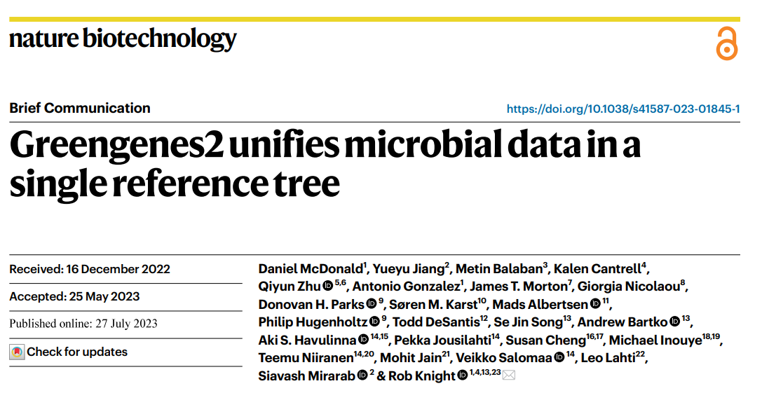
Greengenes2 Database
Integrated resource containing links to other widely used databases like Genome Taxonomy Database, RefSeq and Living Tree Project (LTP)

Slide 16
SILVA Database
SILVA Database
Weblink: https://www.arb-silva.de/
A comprehensive on-line resource for quality checked and aligned ribosomal RNA sequence data
SILVA provides comprehensive, quality checked and regularly updated datasets of aligned small (16S/18S, SSU) and large subunit (23S/28S, LSU) ribosomal RNA (rRNA) sequences for all three domains of life (Bacteria, Archaea and Eukarya).
Current Release: https://www.arb-silva.de/documentation/release-138/

Slide 17
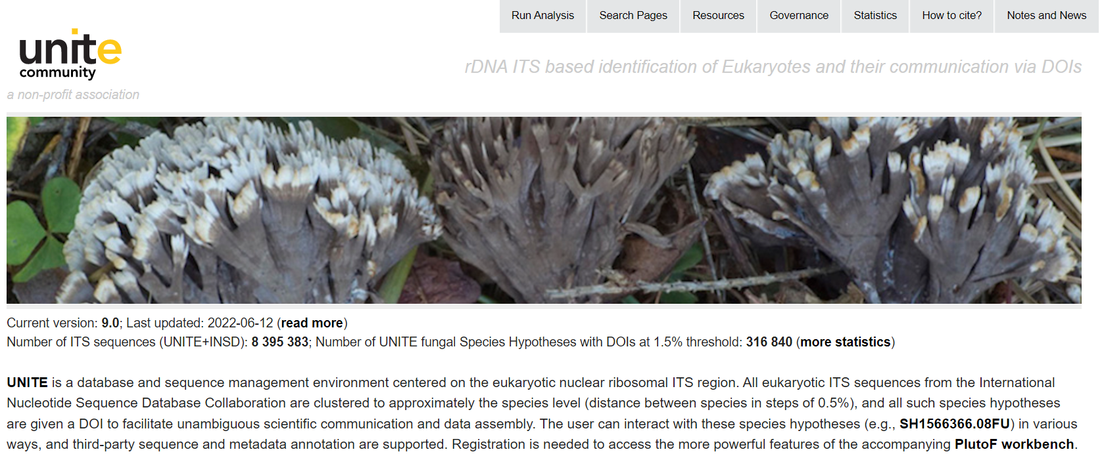
UNITE
UNITE Database
Weblink: https://unite.ut.ee/#main
ITS/18S specific database

Slide 18
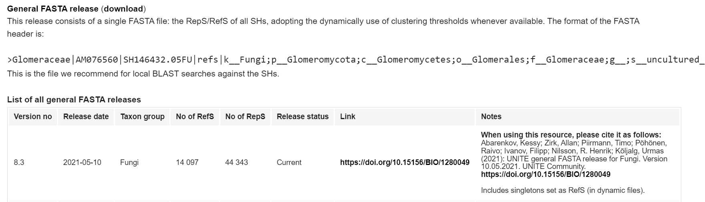
UNITE
UNITE Data Download Link: https://unite.ut.ee/repository.php

Slide 19
Whole genome sequencing DBs

Slide 20
NCBI Databases
NCBI Genome: (RefSeq and GeneBank)
https://www.ncbi.nlm.nih.gov/datasets/genome/
NCBI-nr:
https://www.ncbi.nlm.nih.gov/refseq/about/nonredundantproteins/
NCBI-nt:
https://www.ncbi.nlm.nih.gov/nucleotide/

Slide 21
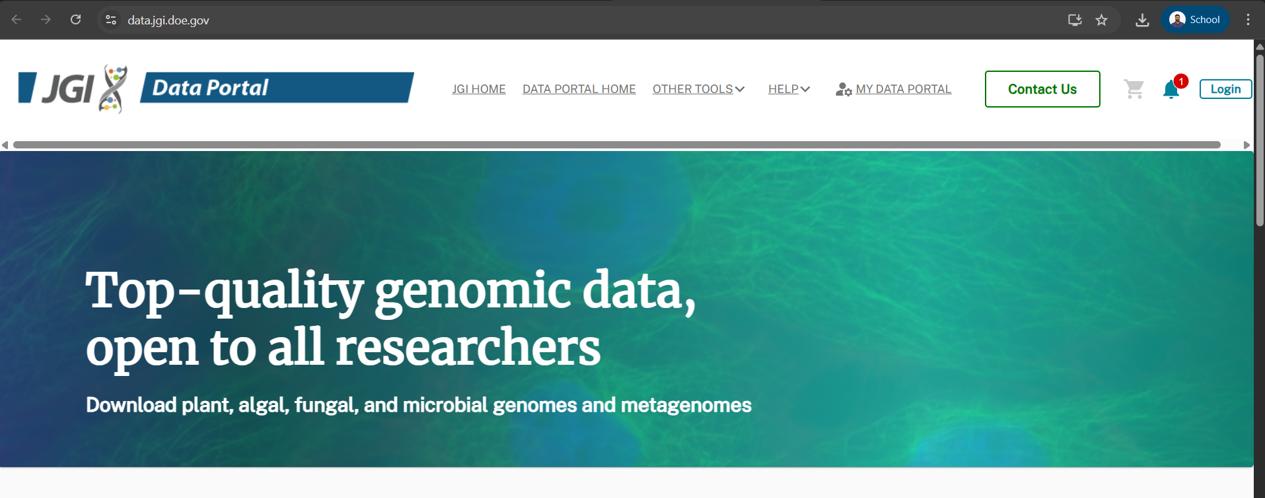
JGI (Joint Genome Institute)
https://data.jgi.doe.gov/
Mainly focuses on non-human organisms
Contains Genomes, Transcriptomes, Epigenomes etc

Slide 22
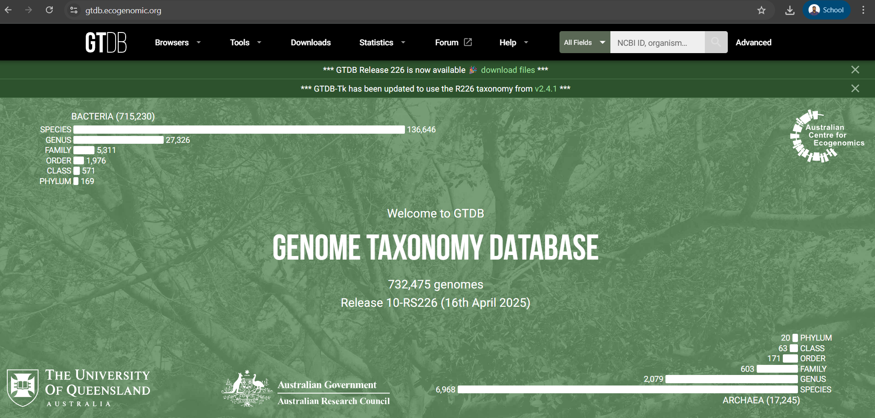
Genome Taxonomy Database (GTDB)
https://gtdb.ecogenomic.org/
Contains only Good Quality Genomes of Bacteria and Archaea

Slide 23
Metaphlan/Chocophlan
Clade-Specific Marker Gene Database
DB: http://cmprod1.cibio.unitn.it/biobakery4/metaphlan_databases/mpa_vJan21_CHOCOPhlAnSGB_202103_marker_info.txt.bz2
GITHUB: https://github.com/biobakery/MetaPhlAn/wiki/MetaPhlAn-4
ChoCoPhlAn Database:
Paper: https://elifesciences.org/articles/65088
Github: https://github.com/biobakery/MetaPhlAn/wiki/HUMAnN-Workshop-on-Genomics-2023

Slide 24
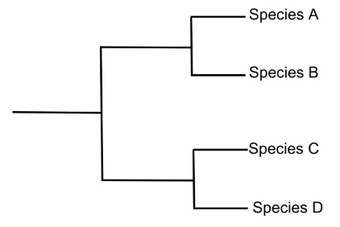
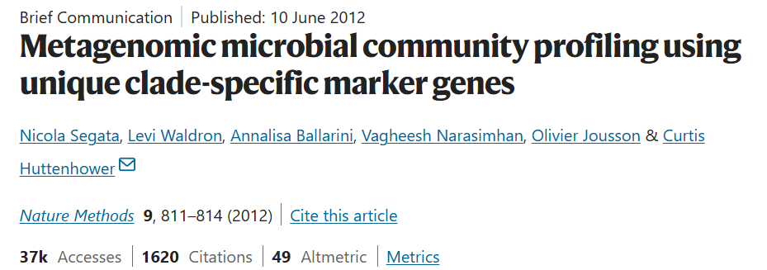
Clade-Specific Marker Gene Database
What is a Clade ?
A clade represents a “single branch” - starting from a node (the common ancestor) and including all connected descendants
Genus1
Family1
Genus2
Marker Genes that are specific to a clade are generated at different levels and can be used for Taxonomic Classification

Slide 25
Clade-Specific Marker Gene Database
Clad-Specific Marker Gene Database is inbuilt in the MetaPhlAn tool (taxonomic profiling of WGS data)
~ 5.1M unique clade-specific marker genes (2024)
Link for Metaphlan4:
https://github.com/biobakery/MetaPhlAn/wiki/MetaPhlAn-4
Link for Clad specific marker gene DB
http://cmprod1.cibio.unitn.it/biobakery4/metaphlan_databases/mpa_vJan21_CHOCOPhlAnSGB_202103_marker_info.txt.bz2

Slide 26
ChocoPhlAn Database
ChocoPhlAn is a pangenome reference database used primarily in metagenomic functional profiling.
A pangenome is the entire set of genes found across all strains of a particular species (or group of closely related organisms)
It is particularly used in HUMAnN (The HMP Unified Metabolic Analysis Network) a Functional Profiling tool and is indeed inbuilt
Link for HUMAnN:
Paper: https://elifesciences.org/articles/65088
Github: https://github.com/biobakery/MetaPhlAn/wiki/HUMAnN-Workshop-on-Genomics-2023

Slide 27
Functional Reference Databases

Slide 28
Functional Databases
MetaCyc:
https://metacyc.org/
KEGG:
https://www.kegg.jp/
COG:
https://www.ncbi.nlm.nih.gov/research/cog-project/
4) Pfam:
http://pfam.xfam.org/
5) CAZy:
http://www.cazy.org/
6) CARD:
https://ardb.cbcb.umd.edu/
https://card.mcmaster.ca/
7) UNIPROT:
https://www.uniprot.org/

Slide 29
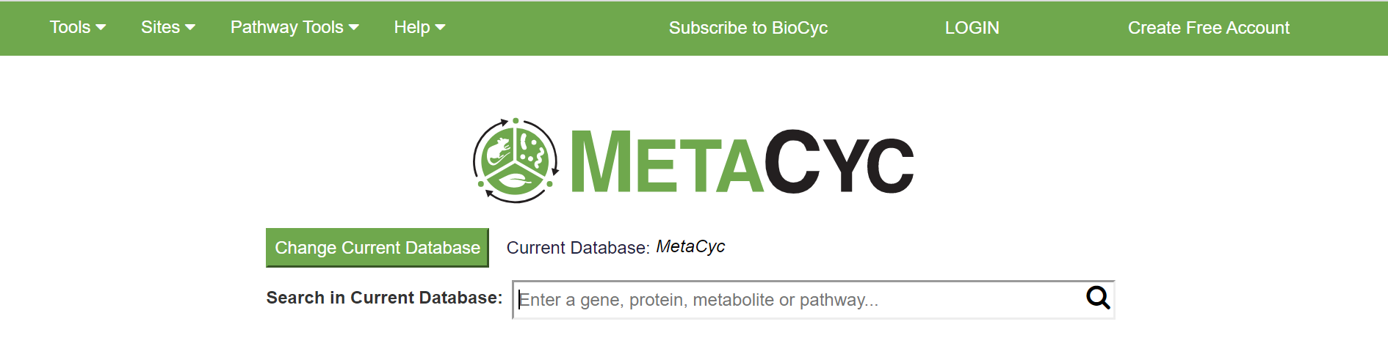
MetaCyc
https://metacyc.org/
It is a curated database of experimentally elucidated list of pathways from all domains of life
Both primary and secondary metabolism pathways, as well as the associated metabolites, reactions, enzymes, and genes
MetaCyc currently contains 2937 pathways, 17,780 reactions and 18,124 metabolites

Slide 30
MetaCyc
Modular Hierarchy
Individual Genes/Proteins
Reactions
Pathways
Gene/Protein sequences (with E.C.)
Reaction
Pathway
Gene/Protein sequences (with E.C.)
Reaction
Gene/Protein sequences (with E.C.)
Metabolite Intake/Consumption
Gene/Protein sequences (with E.C.)
Reaction
Pathway

Slide 31
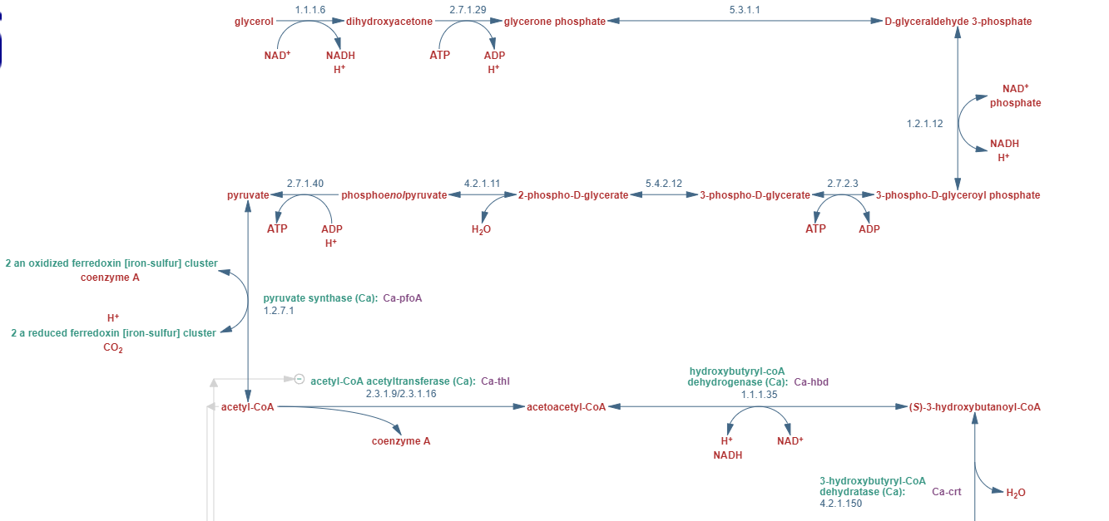
MetaCyc
These are detected from reads and gene sequences
Individual Enzymes
Reactions
Reactions
Individual compounds / Metabolites
An example of a part of a pathway

Slide 32
MetaCyc
Pathways are further classified into three different hierarchical levels (or classes and super-classes) or super pathways

Slide 33
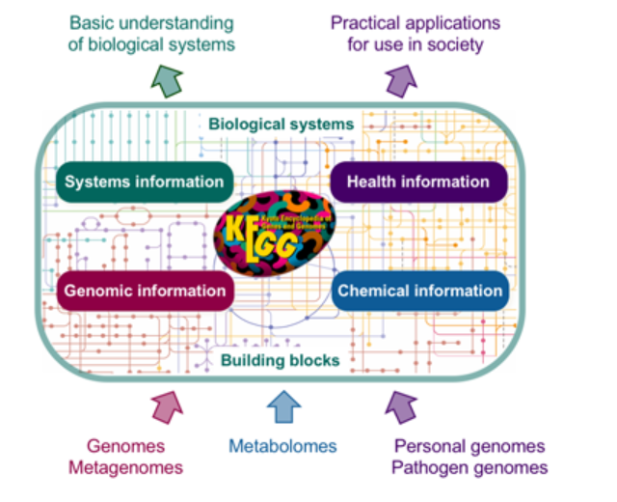
KEGG
https://www.kegg.jp/
Another hierarchically arranged functional database
Contains much more information besides the functional pathway and metabolite association to different genes and proteins

Slide 34
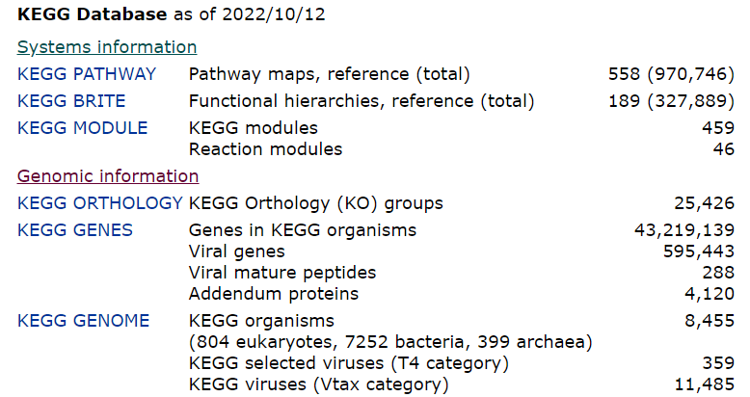
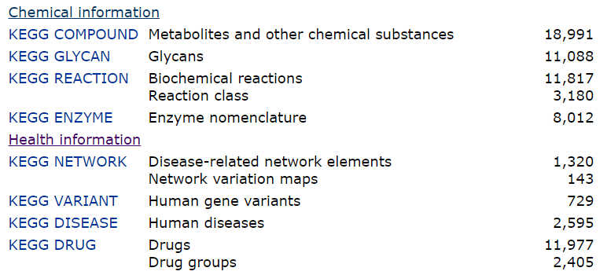
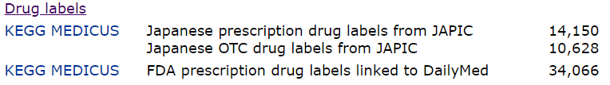
KEGG
Genes, Orthology, Modules and Pathways: We mainly concentrate here
Metabolites and Reactions: Partly concentrate here sometimes
Disease, Disease Networks, Variants, Drugs: Rarely

Slide 35
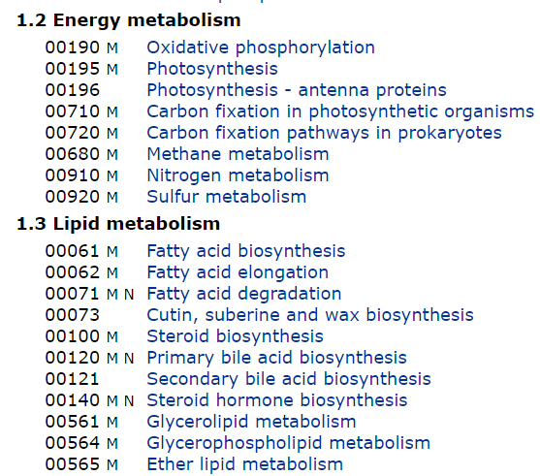
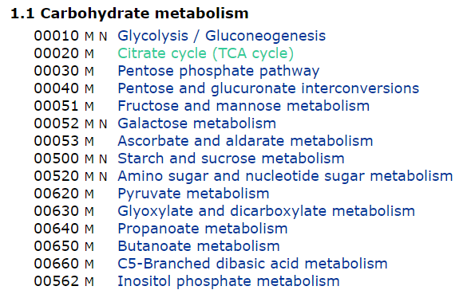
KEGG
Similar Modular Hierarchy:
KEGG Genes > KEGG Orthology > KEGG Reaction Modules > KEGG Pathways
KEGG Pathways are further grouped at different levels
https://www.kegg.jp/kegg/pathway.html
https://www.kegg.jp/kegg/pathway.html#genetic
Some Examples

Slide 36
COG
https://www.ncbi.nlm.nih.gov/research/cog-project/
Clusters of Orthologous Groups
Orthologous groups of protein sequences from all completely sequenced genomes
Complete genomes of 1187 bacteria and 122 archaea
4877 COGs that include 3,236,575 unique genes mapped to 3,455,867 genomic loci, which represents 73.5% of the 4 401 819 proteins (4,110,746 bacterial and 291,073 archaeal proteins) encoded by the covered species.

Slide 37
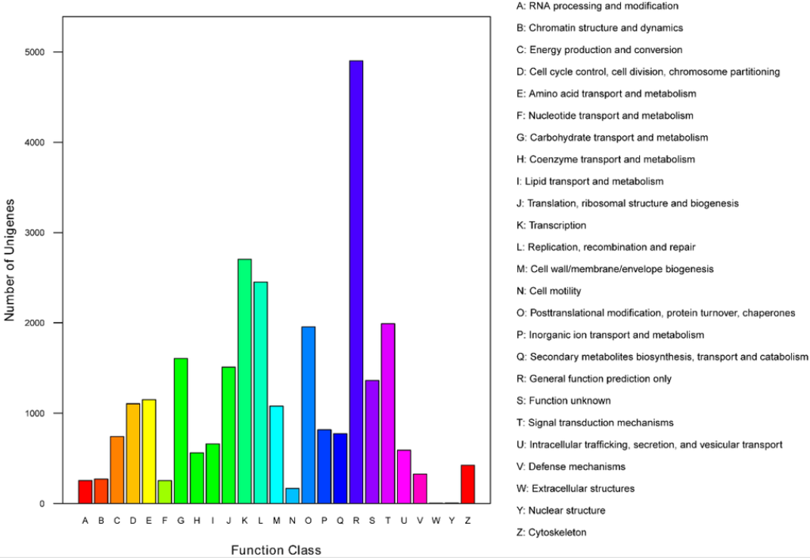
COG
Similar hierarchical classes

Slide 38
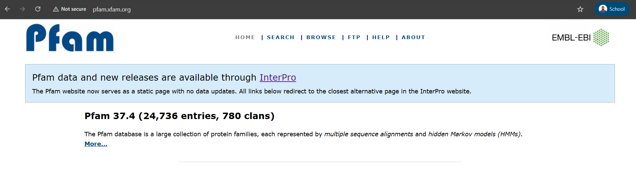
Pfam
Protein families database
Protein families are further grouped into Clans
http://pfam.xfam.org/

Slide 39
CAZy
http://www.cazy.org/
CAZy: Database of CAZymes
Database of carbohydrate binding and degrading modules and genes
Collectively referred to as CAZymes (Carbohydrate Active Enzymes)
Important for understanding the C-nutrient-specific requirements for microbiome members
To understand response to different media including food

Slide 40
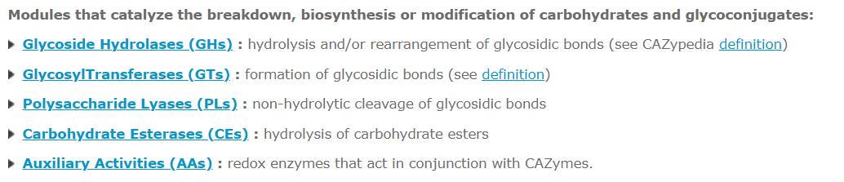
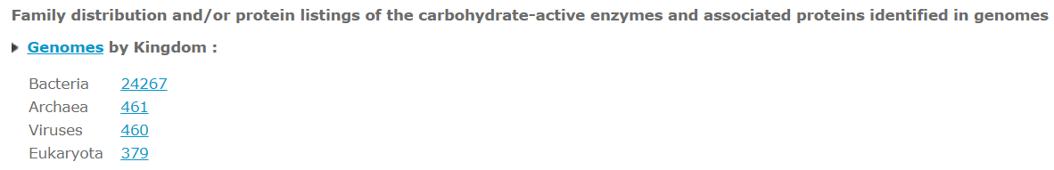
CAZy
Enzymes divided into different kind of groups
Microbes have much greater diversity of CAZymes

Slide 41
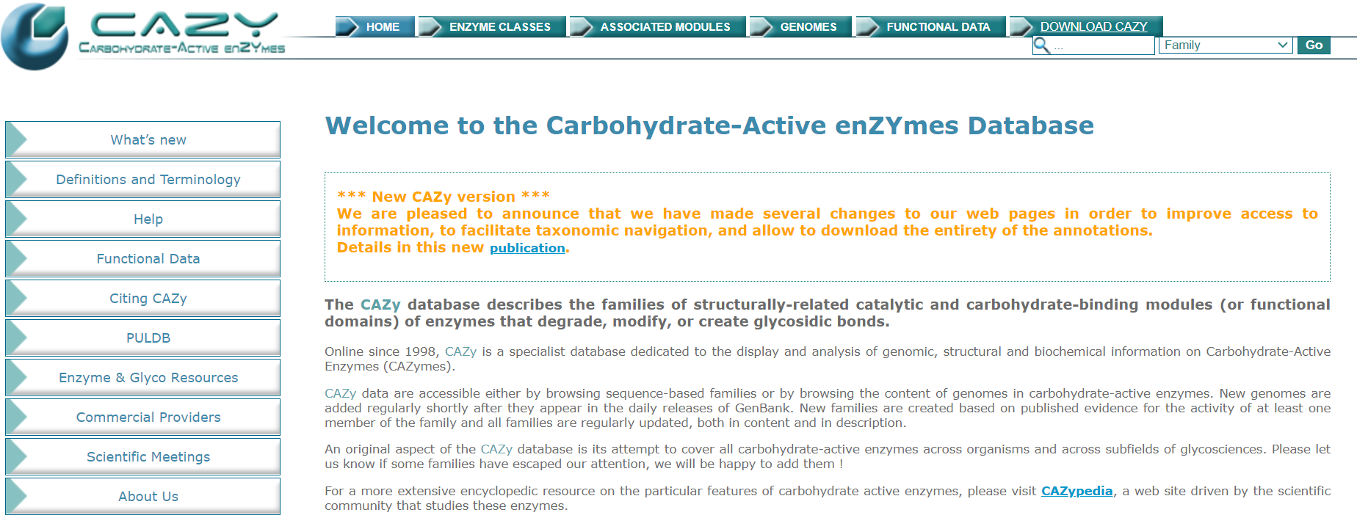
CAZy

Slide 42
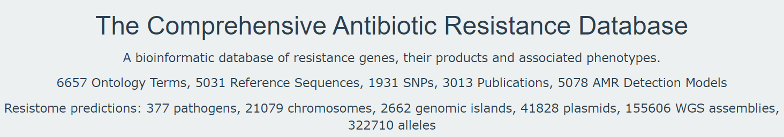
CARD
Both databases can be used for profiling antibiotic resistance genes in metagenomics
CARD
https://ardb.cbcb.umd.edu/
https://card.mcmaster.ca/

Slide 43
UNIPROT
All Reference Databases described above have their own accession number formats for the different genes/protein sequences
Own classification hierarchy
Not compatible
This is to a large extent addressed by mapping reads and metagenomic sequences to a single largest sequence database and then creating cross maps between the accession numbers of this database to those of other databases.

Slide 44
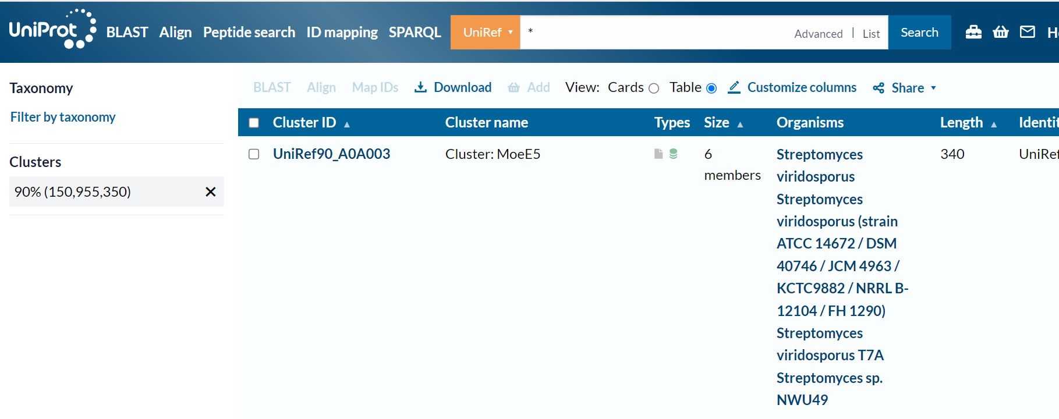
UNIPROT
Such a database is UNIPROT
https://www.uniprot.org/
Currently one of the world’s largest and most comprehensive data repositories
150 million sequence clusters
After grouping homologues with 90% identity

Slide 45
UNIPROT
UNIPROT also has cross maps to other databases like CAZy and E.C.
Most mapping pipelines utilize UNIPROT
KEGG
Cross Mappings
COG
UniProt
MetaCyc
CAZy
Incase cross mappings are not available, they can be created by performing alignment searches of sequences in one database with the other and identifying close matches
CARD

Slide 46
Microbiome Databases

Slide 47
Microbiome Databases
These are databases which contain information derived from previously published microbiome studies
May contain sequences from various samples of studies with sample-specific metadata
May also contain taxonomic and functional profiles of microbiomes from previously studies along with metadata
May contain assembled genomes from metagenomes or isolated genomes of species from different microbiome samples

Slide 48
Microbiome Databases
Three Types:
General Sequence Databases:
ENA (European Nucleotide Archive)
NCBI (National Center for Biotechnology Information)
DDBJ (DNA Data Bank of Japan)
China National GeneBank Database
Customized Microbiome Databases (majority contain processed profiles with cross-links to their sequence accession links above):
1) curatedMetagenomicData:
MicrobiomeHD
MetagenomeDB
QIITA
GMRepo
Human Microbiome Compendium
HACK Profiles Repository (Our Own Creation)

Slide 49
Microbiome Databases
Metagenome Assembled Genomes
CIBIO Univ. Naples Italy
UHHG (or MGNify)

Slide 50
General Databases

Slide 51
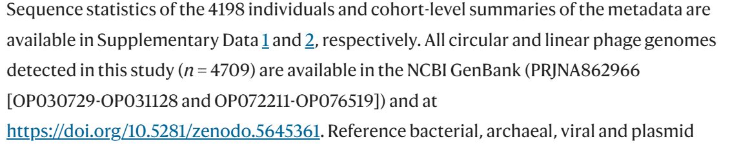
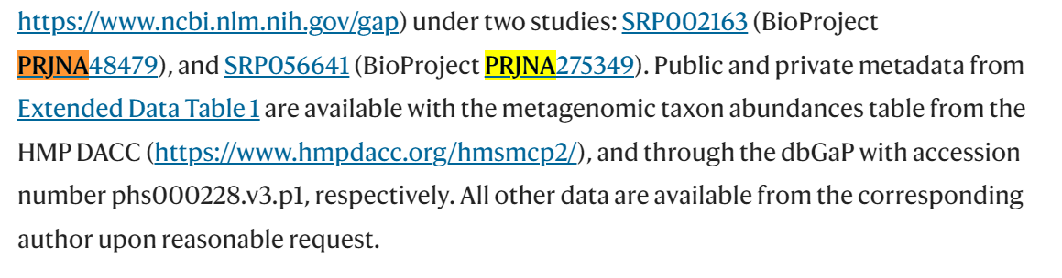
Microbiome Databases: ENA<>NCBI<>DDBJ
Generally contain ‘raw’ reads which may be quality filtered
Papers corresponding to different studies generally provide a link

Slide 52
What do the prefix mean?
PRJNA: Data deposited to NCBI
PRJEB: Data deposited to ENA
PRJDB: Data deposited to DDBJ

Slide 53
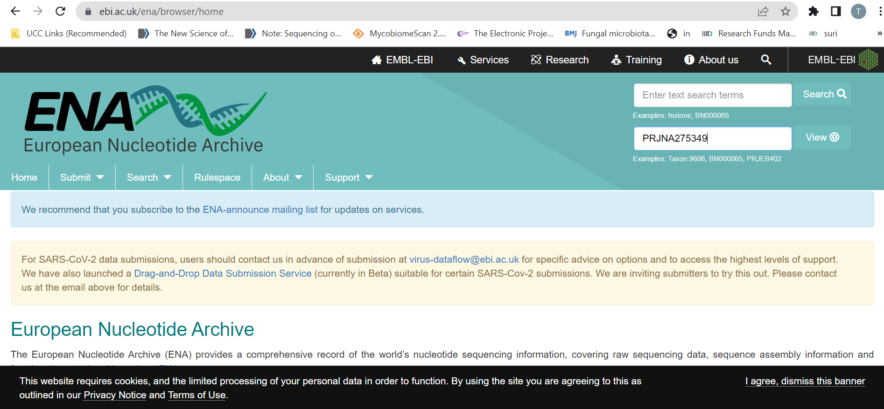
How to download data
https://www.ebi.ac.uk/ena/browser/home
Enter the accession number in the Search Term

Slide 54
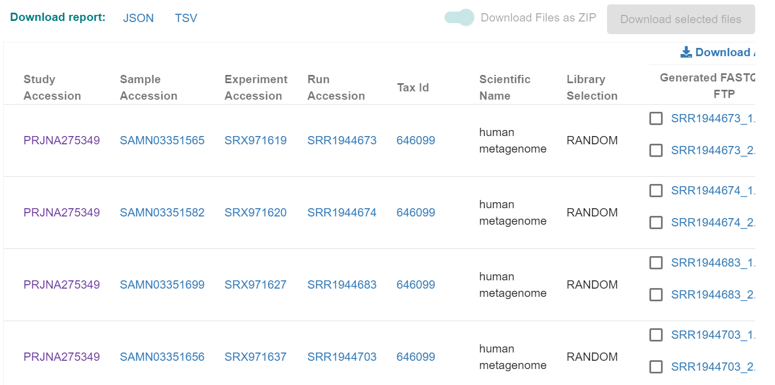
How to download data
It will open the file repository list
You can either download the entire repository list
You can select specific file list and download

Slide 55
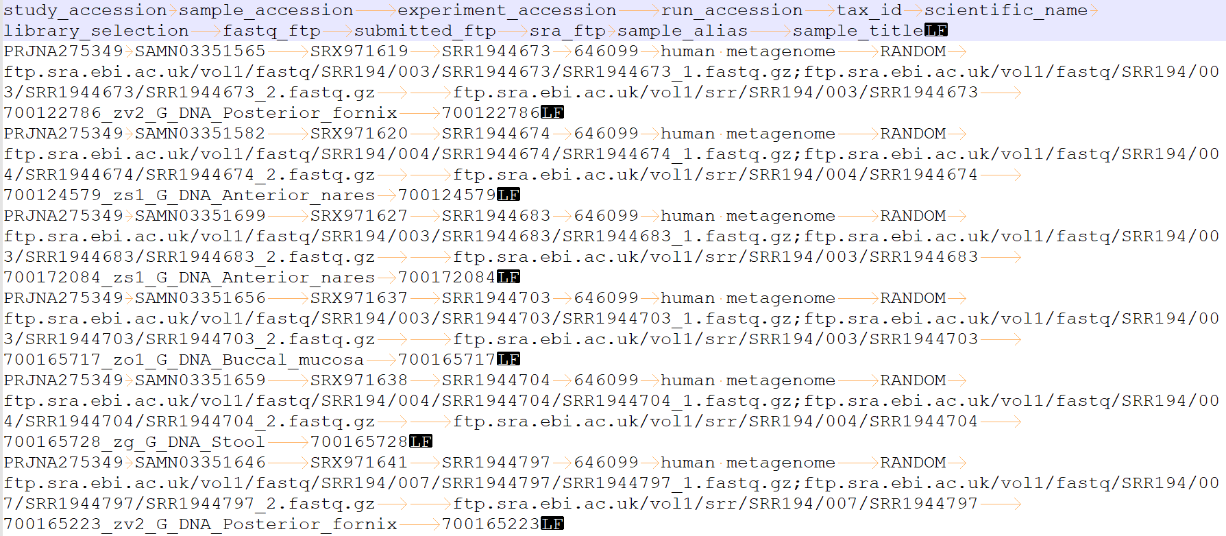
How to download data
Benefits of adding the repository list as tsv file
You can write a “wget” shell to download the entire fastq dataset in one go

Slide 56
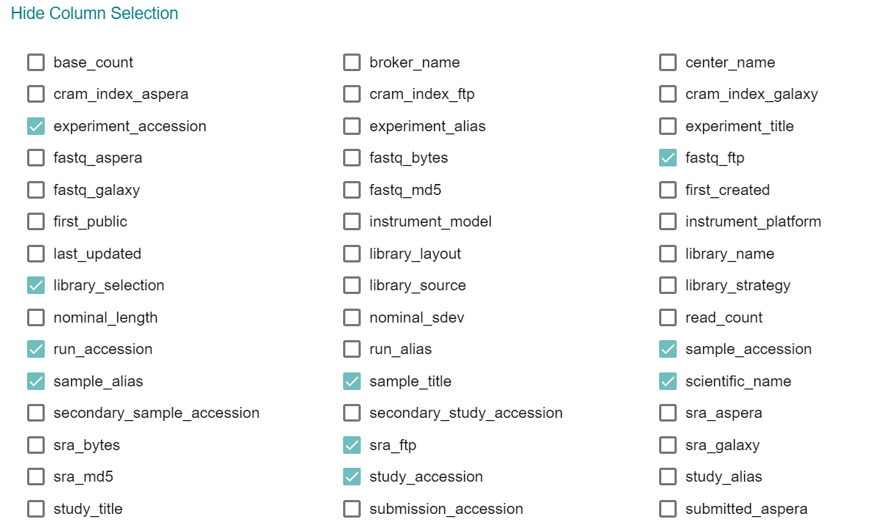
How to download data
You can also customized the fields you wish to include in the tsv

Slide 57
One limitation
These just contain the sequence data
Almost no host metadata is available
These have to be either obtained from the papers or by contacting authors
Some authors although do deposit some metadata here.
It can be accessed using the ‘Run Selector’ option in NCBI SRA

Slide 58
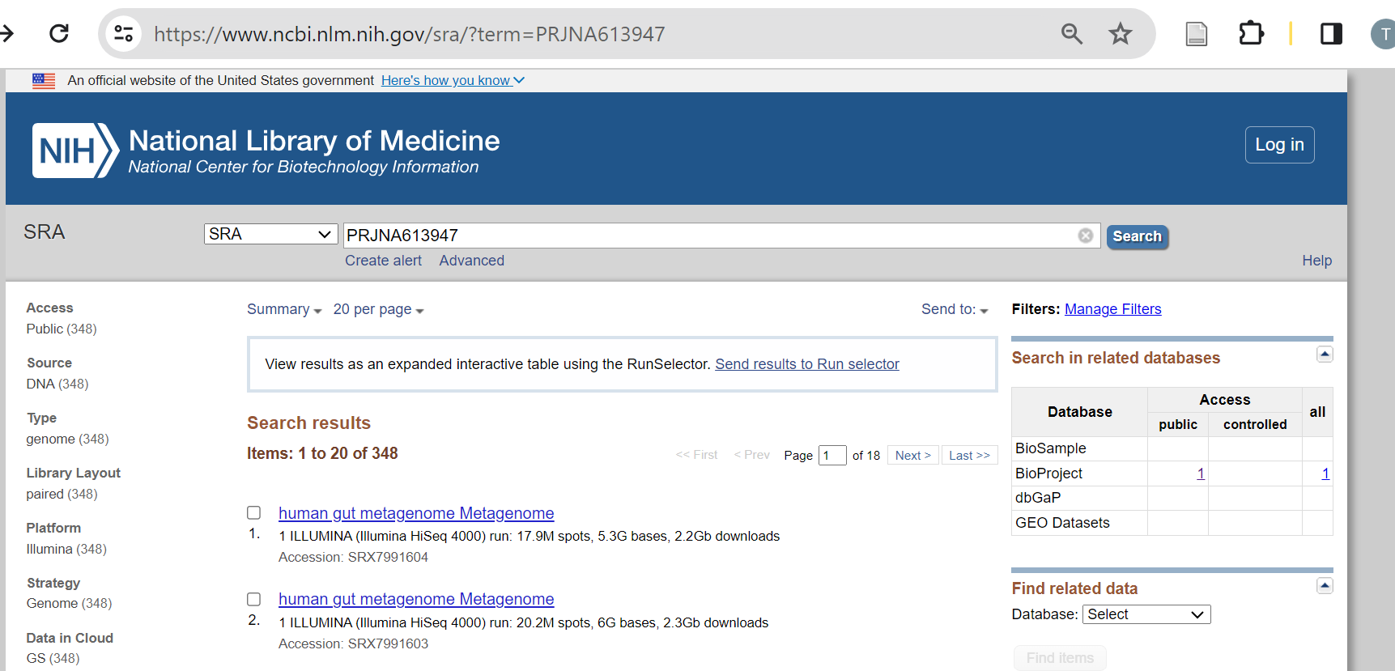
Using the Run Selector option to get Metadata
https://www.ncbi.nlm.nih.gov/sra

Slide 59
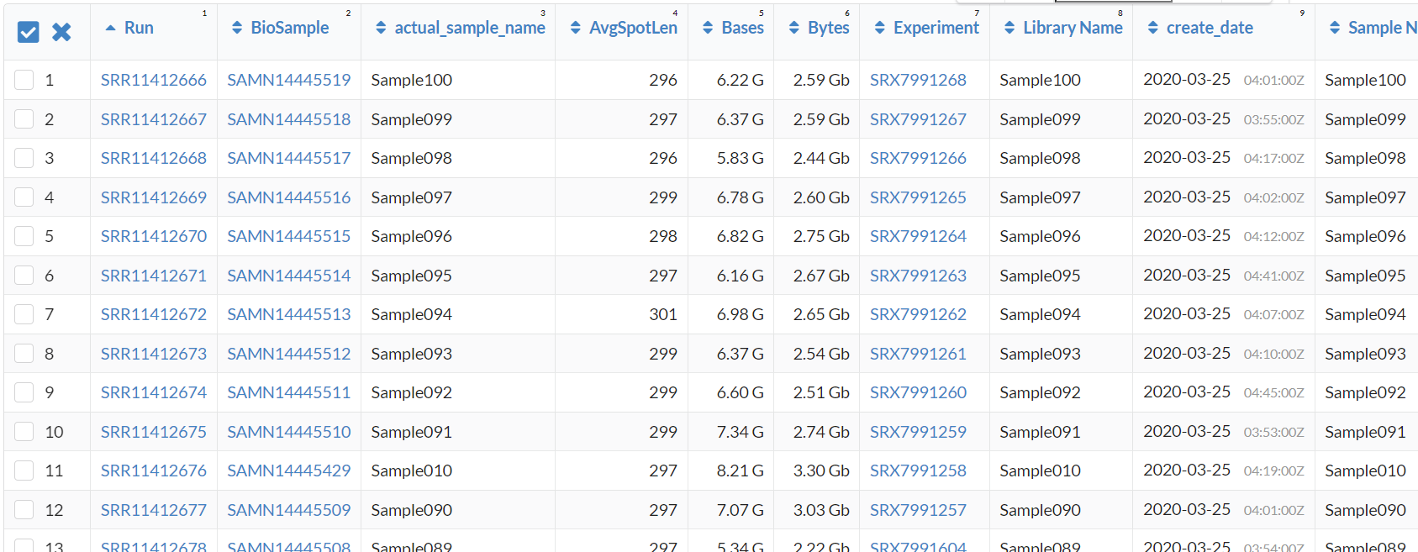
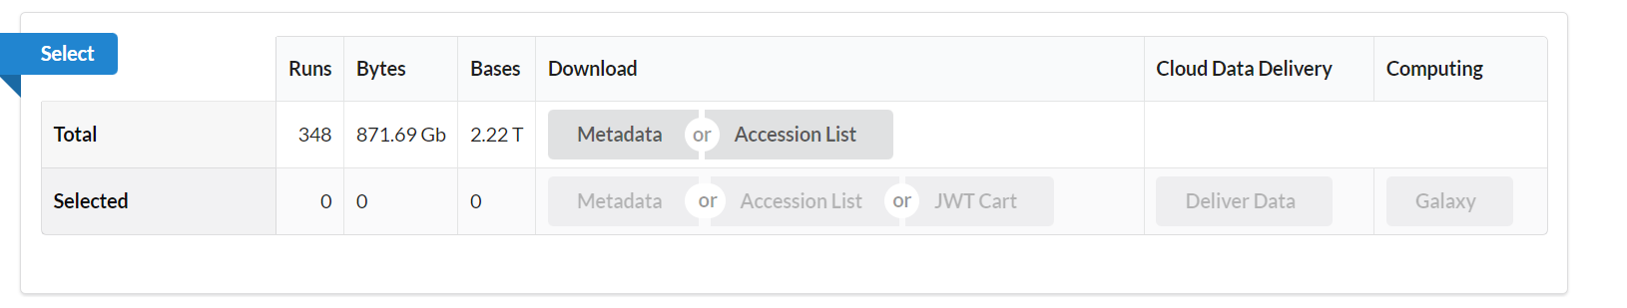
Using the Run Selector option to get Metadata
You can download by clicking on the metadata option at the top

Slide 60
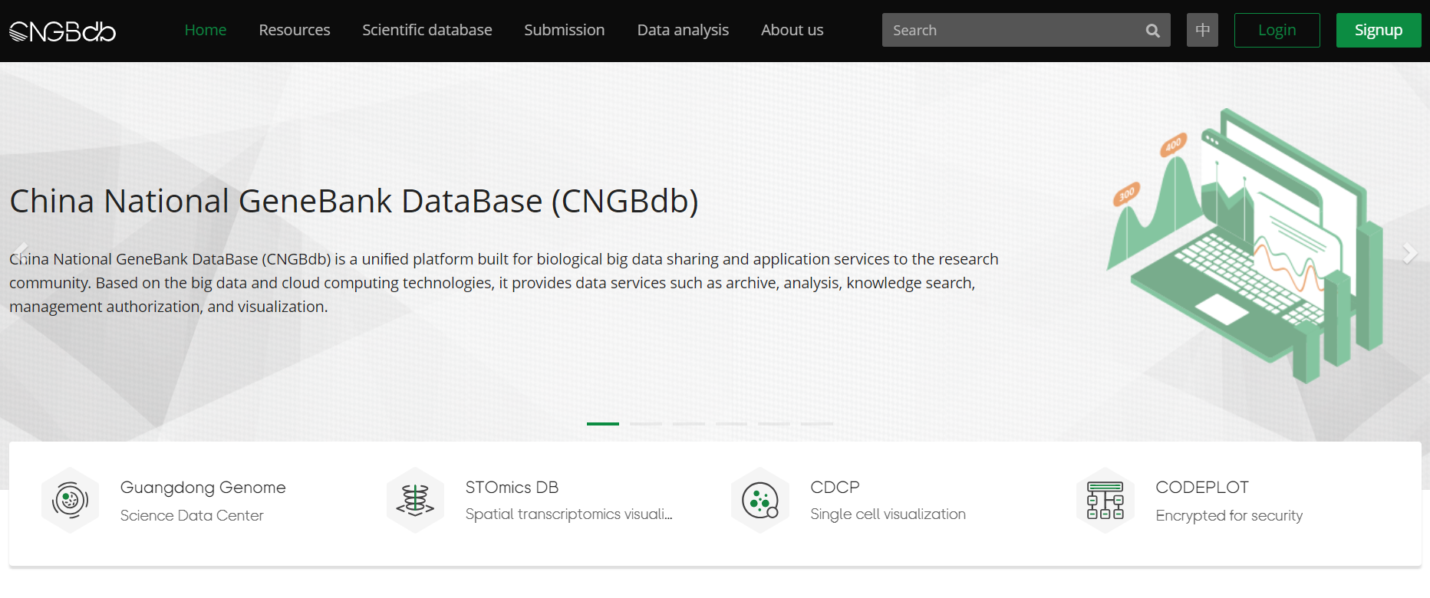
China National GeneBank Database (CNGB)
https://db.cngb.org/

Slide 61
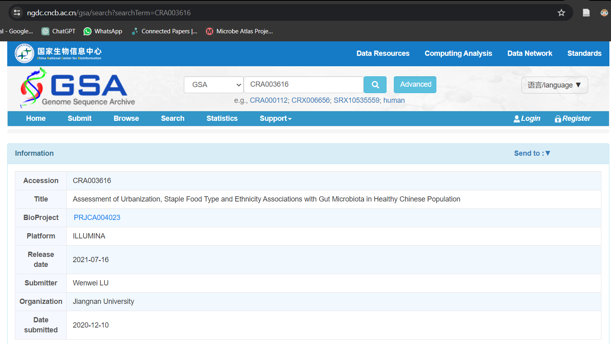
China National GeneBank Database (CNGB)

Slide 62
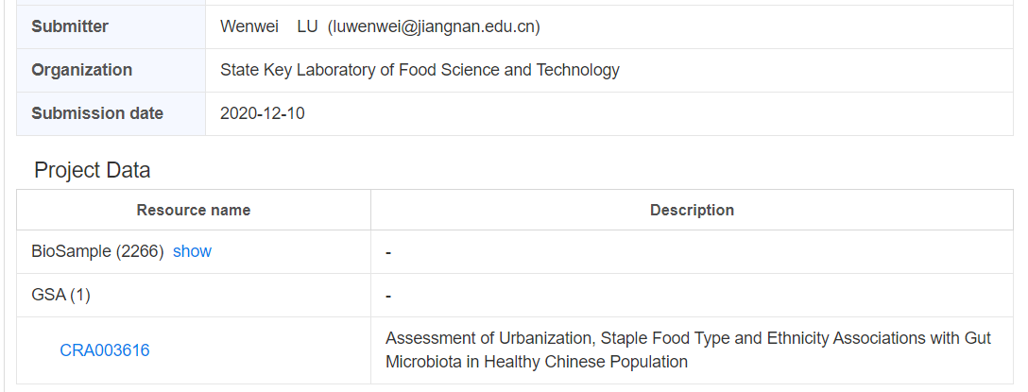
China National GeneBank Database (CNGB)

Slide 63
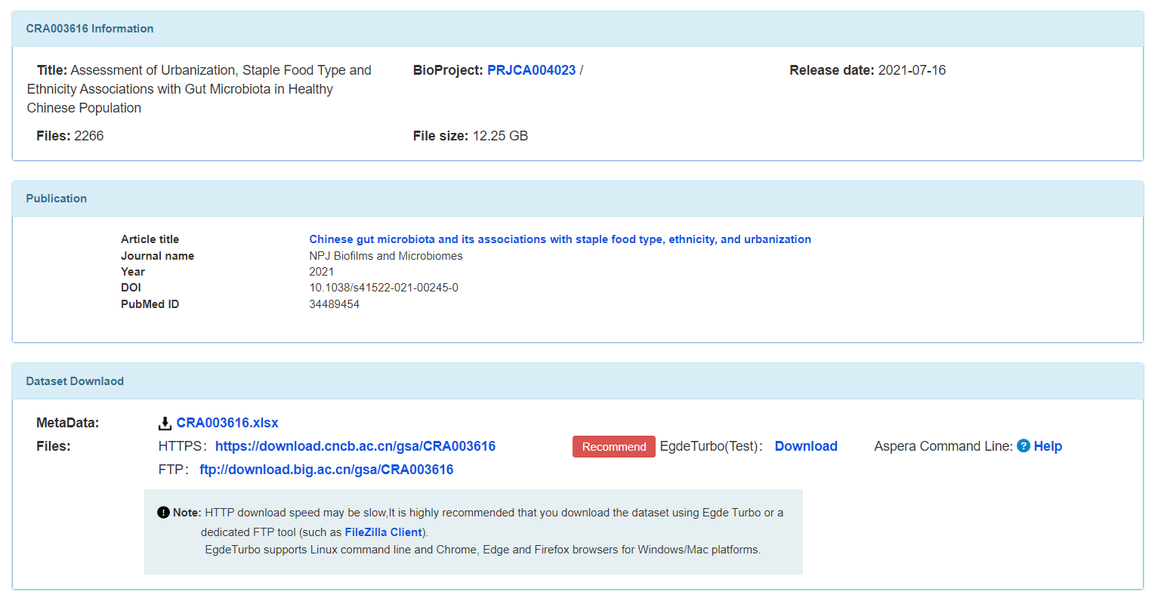
China National GeneBank Database (CNGB)
Clicking on it

Slide 64
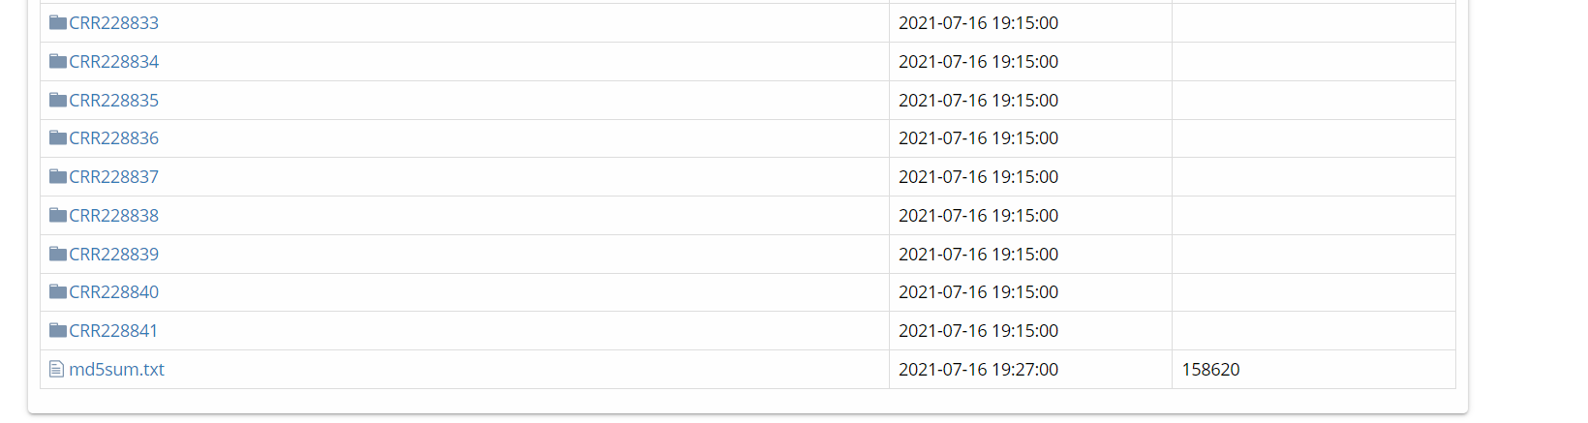
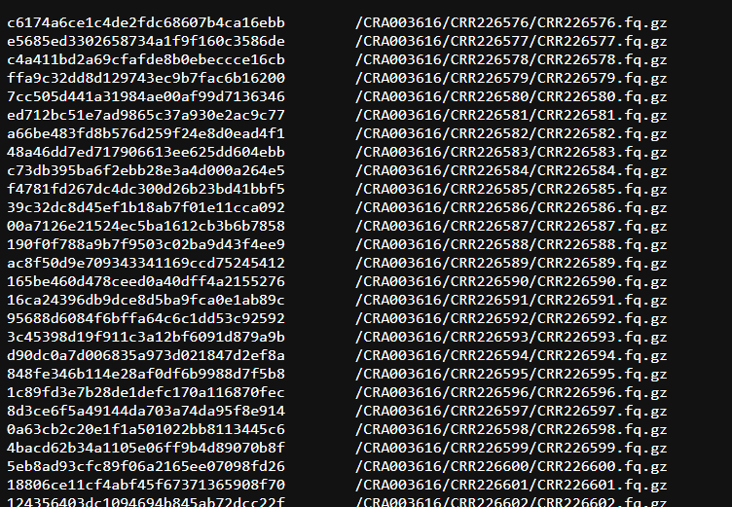
China National GeneBank Database (CNGB)

Slide 65
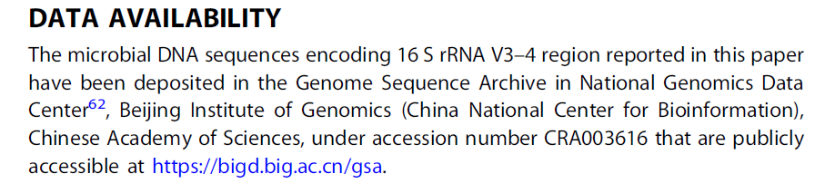
China National GeneBank Database (CNGB)
Data Availability Statement

Slide 66
Alternatively ..
This limitation has been addressed to some extent by metagenome/microbiome customized databases
These also collate a subset of host metadata for the datasets that they include

Slide 67
Customized Microbiome Database

Slide 68
Customized Microbiome Databases
These databases contain
Metagenomic sequence data or processed microbiome abundance profile (species, genus or pathways)
Host Metadata corresponding to each of the samples

Slide 69
curatedMetagenomicData
Contains > 40,324 shotgun human microbiome profiles from 20853 subjects > 86 studies from multiple human body sites (38 countries)
95% of data is from gut.
With matched host metadata of specific attributes
Approach used to create the profiles
Metagenomic
Reads
Taxonomic Profiling
Functional Profiling
Add profiles to repository
Metaphlan3
humann3

Slide 70
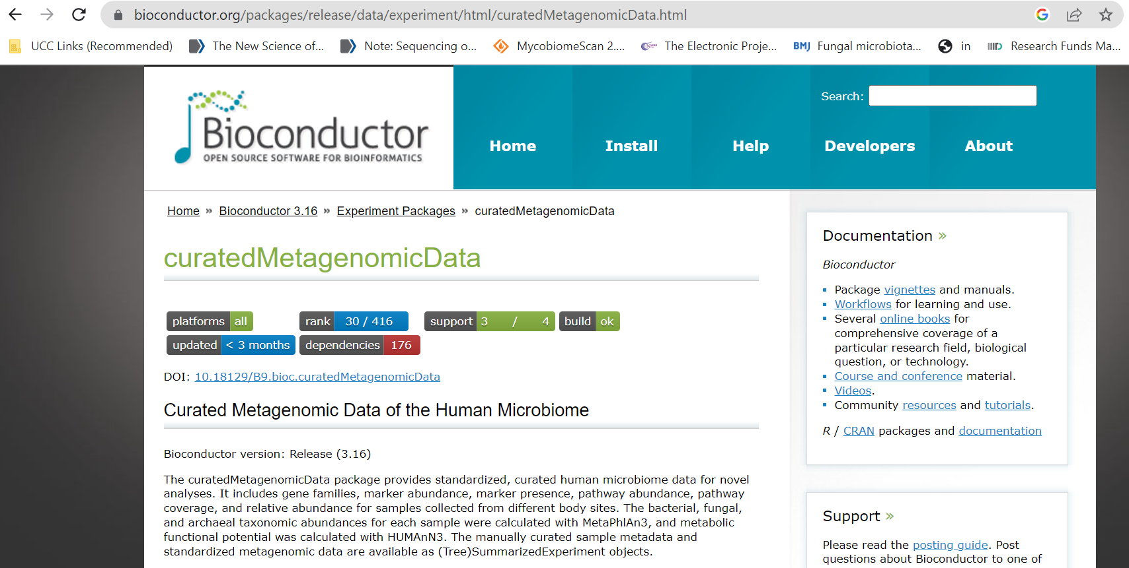
curatedMetagenomicData
Available as a R-library from Bioconductor repository

Slide 71
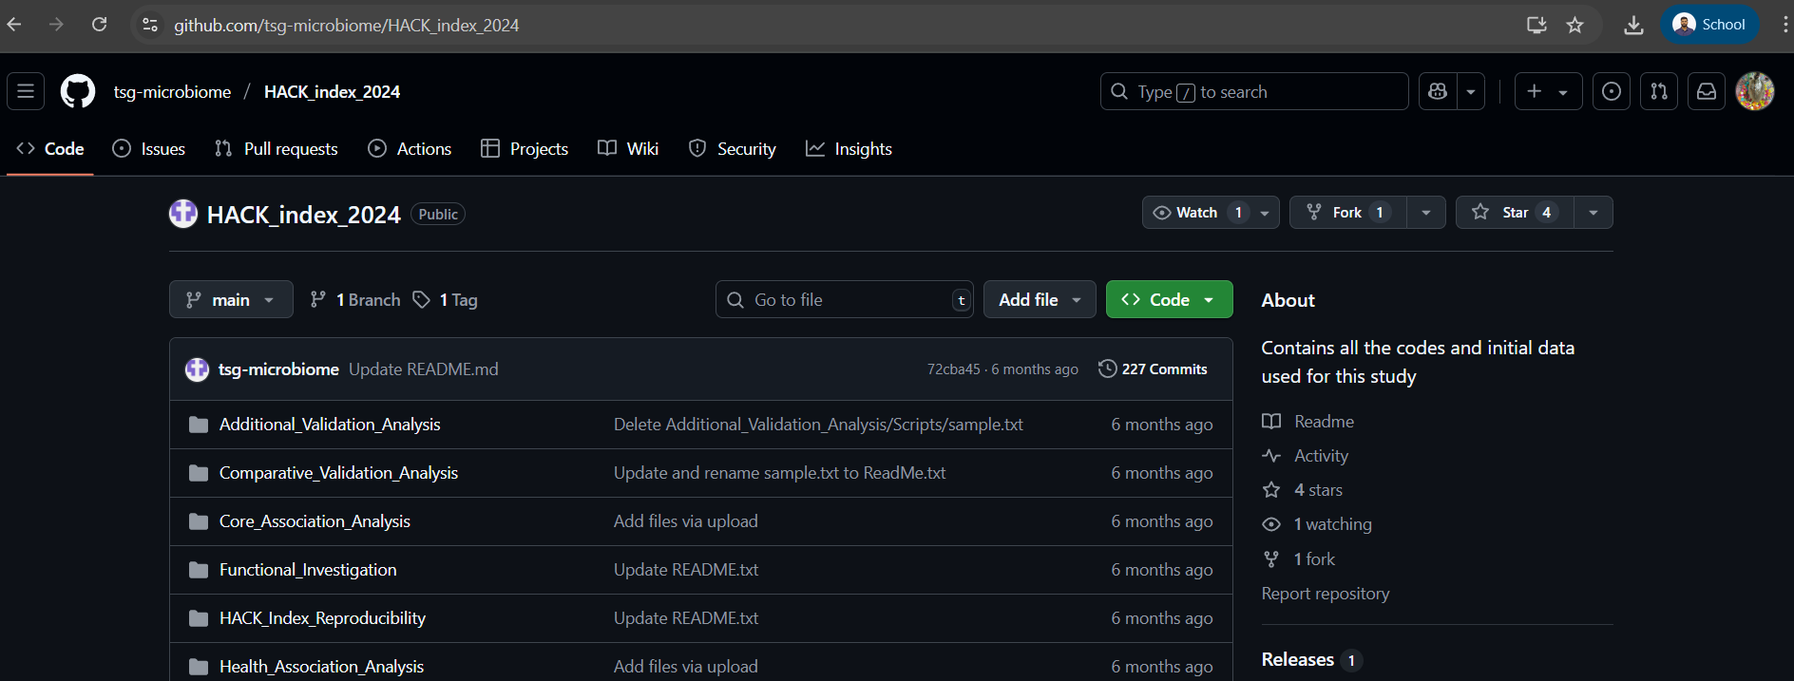
HACK Data Repository (from IIIT-Delhi)
This Repository is the extended version of curatedMetagenomicData repository
It contains WGS as well as 16S samples with their metadata
https://github.com/tsg-microbiome/HACK_index_2024

Slide 72
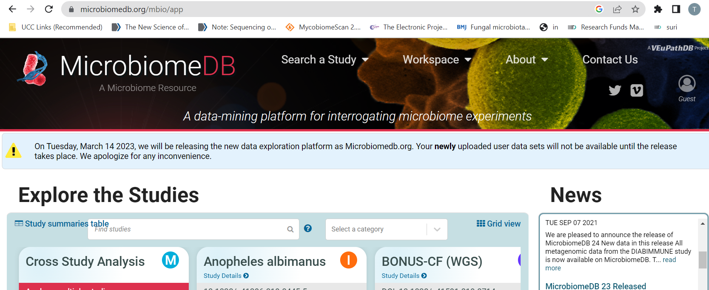
MicrobiomeDB
Both 16S and Shotgun
Processed profiles (Shotgun: Metaphlan3/humann3 and 16S: DADA2/Silva)
Not only human but also other sources

Slide 73
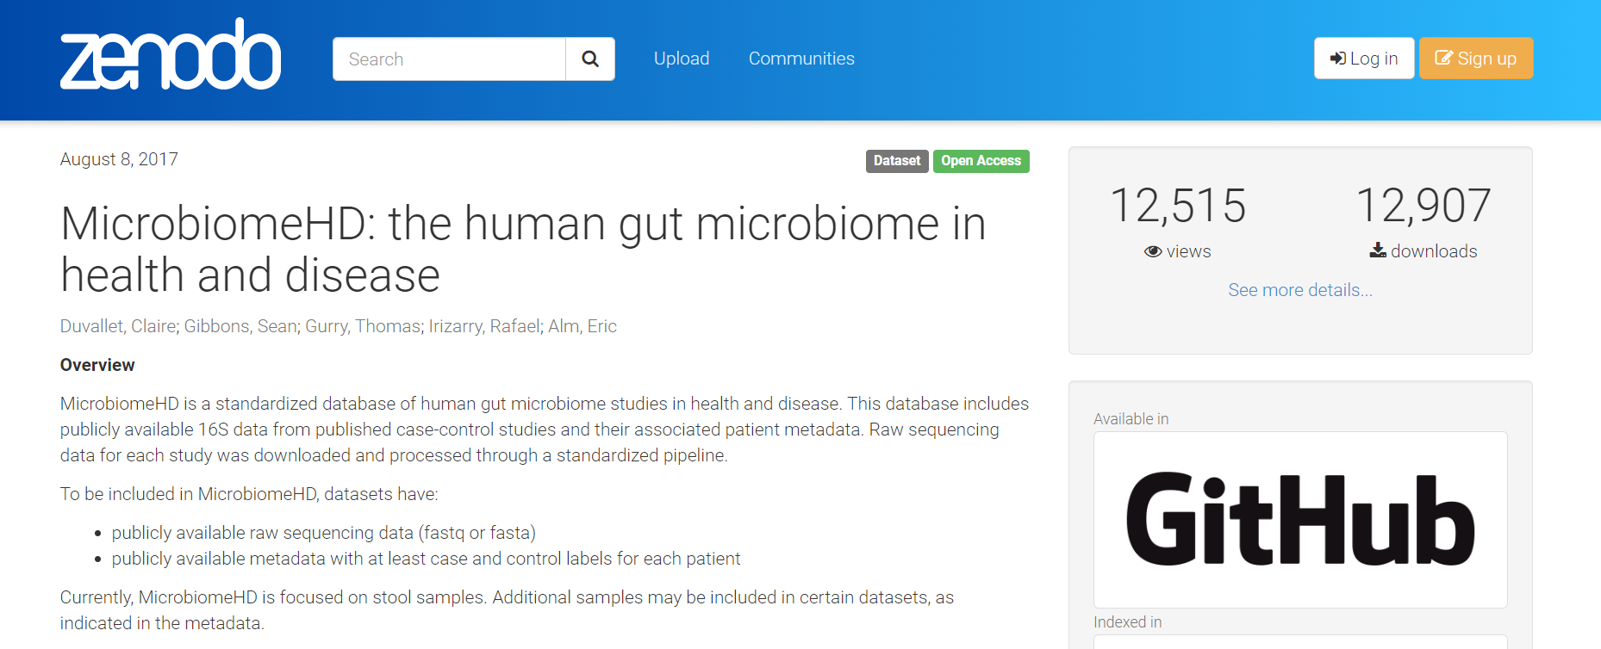
MicrobiomeHD
Repository of 16S gut microbiome datasets for case – control studies in multiple diseases

Slide 74

MicrobiomeHD
For each dataset
Representative OTU sequences
Taxonomic Classification of each OTU obtained using both RDP classifier and SILVA hits
OTU abundance table
Host Metadata

Slide 75

MicrobiomeHD
Datasets can be downloaded as zip files

Slide 76

QIITA
Huge but complex
Multiple Body Sites and contains 16S as well as WGS data
http://metadata-wizard-tutorial.readthedocs.io/en/latest/

Slide 77


QIITA
Two ways to search: By QIITA Study ID & By general search term
By QIITA Study ID

Slide 78

QIITA
By General Search Terms

Slide 79

QIITA
Based on the match of the search terms in the abstract or title it will produce a list of studies

Slide 80

GMRepo
https://gmrepo.humangut.info/home
Gut Microbiome Data Repository

Slide 81

GMRepo
You can go and explore into their data folders

Slide 82

GMRepo
You can also download the metadata of all subjects of a project as TSV files
You can get access to sequence data based on the RunID number

Slide 83

Human Microbiome Compendium (under-development)

Slide 84

Human Microbiome Compendium (under-development)
> 400 studies

Slide 85
Databases of Metagenome Assembled Genomes

Slide 86
Databases of Metagenome Assembled Genomes
Metagenome Assembled Genomes are genomes directly assembled from metagenomic reads of a dataset
Two important MAGs databases
1) UNINA MAGs Database
(http://segatalab.cibio.unitn.it/data/Pasolli_et_al.html)
2) UHGG/UHGP

Slide 87


UNINA MAGs Database
University of Naples Italy (http://segatalab.cibio.unitn.it/data/Pasolli_et_al.html)

Slide 88

UHGG/UHGP

Slide 89
Links
To upload the Metagenomic data to ENA Database
https://www.youtube.com/watch?v=n2kUjY25dPY
(start from 15:30 mins)
Sample collection protocols:
For Fecal sample
1) IHMS (International Human Microbiome Standards)
https://human-microbiome.org/index.php#SOPS
For Oral sample
Molecular Medicine Ireland:
https://brd.nci.nih.gov/brd/sop/download-pdf/147
2) CD-Genomics
https://www.cd-genomics.com/microbioseq/saliva-sample-collection-and-handling-instructions.html

